Slide 1
Exploring SVM Classification
Sama Yousef
202000819

Slide 2
Topics
01
04
Abstract
Implementation
02
Dataset Description
05
Results
03
Approach and Methodology
06
Conclusion

Slide 3
Abstract
This task focuses on using Support Vector Machine (SVM) classification models with varying kernels and regularization to classify datasets.
SVM stands out as a robust algorithm for classification tasks due to its effectiveness.
Understanding how different kernels and regularization influence model performance is essential for selecting and deploying effective models.
The objective is to grasp the impact of different parameters on SVM classification performance, enabling informed decisions in real-world applications.

Slide 4

Aggregation
The Aggregation dataset consists of 788 samples with 2 features and 7 classes. It has a mean of 19.57 and 14.17 for the ﬁrst and second features, respectively.
Datasets
Compound
The Compound dataset includes 399 samples with 2 features and 6 classes. It has a mean of 22.22 and 13.97 for the ﬁrst and second features, respectively.
Flame
The Flame dataset includes 240 samples with 2 features and 2 classes. It has a mean of 7.32 and 20.93 for the ﬁrst and second features, respectively.

Slide 5
Jain
The Jain dataset consists of 373 samples with 2 features and 2 classes. It has a mean of 24.3 and 12.14 for the ﬁrst and second features, respectively.
Datasets
Spiral
The Compound dataset includes 312 samples with 2 features and 3 classes. It has a mean of 18.41 and 16.34 for the ﬁrst and second features, respectively.
Pathbased
The Flame dataset includes 300 samples with 2 features and 3 classes. It has a mean of 18.85 and 17.19 for the ﬁrst and second features, respectively.

Slide 6



Data Pre-processing
01
02
03
Loading the datasets
Scaling the features
Splitting the data into training and testing

Slide 7
Parameters tuning
01
02
kernel
Gamma
Parameters
03
04
C
Degree

Slide 8
kernel
In machine learning, kernels are used to transform data into a higher-dimensional space, making it easier to separate classes of data that are not linearly separable in the original space. Kernels are commonly used in support vector machines (SVM) and other machine learning algorithms to handle complex data relationships.The types of kernels used in the project are:
Linear kernel
Polynomial kernel
Radial Basis Function (RBF) kernel
and the best results produced by RBF

Slide 9
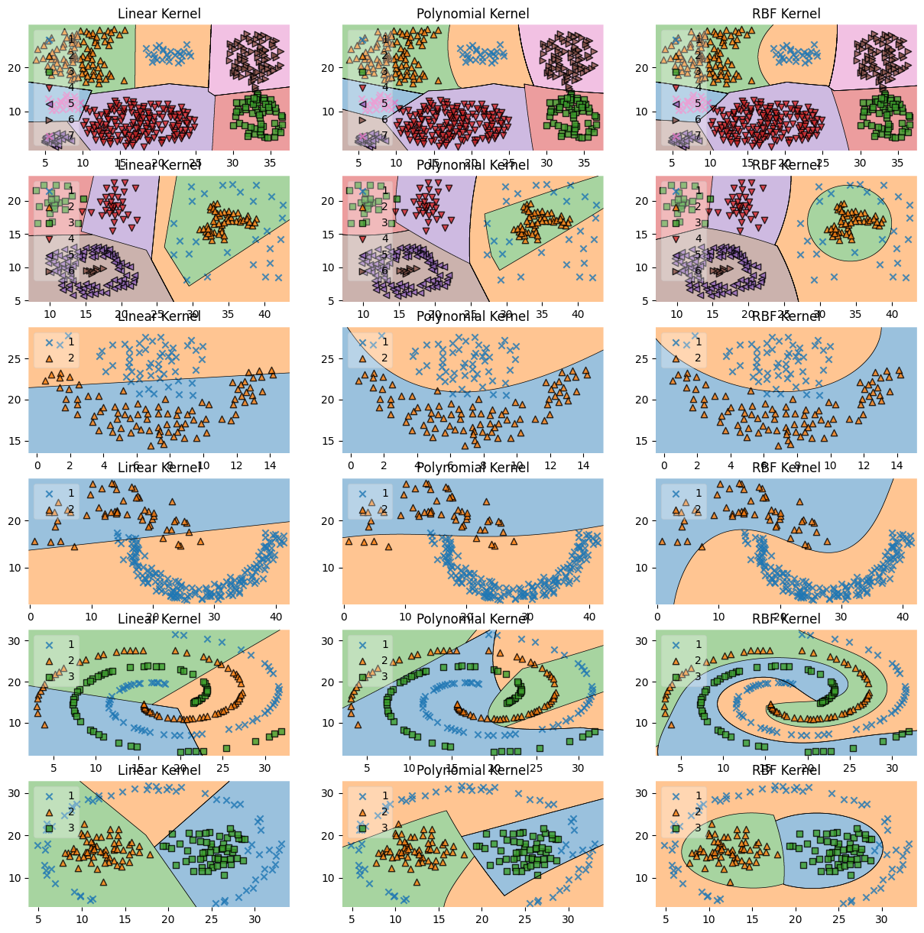

Slide 10
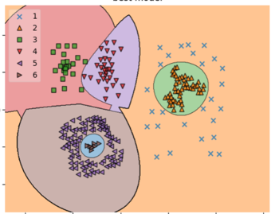
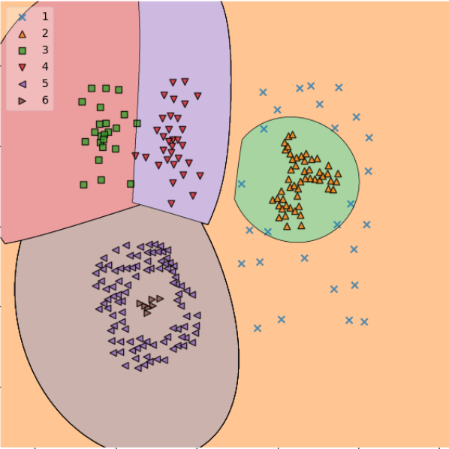
Parameter C
The parameter C in machine learning is used in algorithms such as support vector machines to control the trade-off between allowing training errors and forcing rigid margins. A lower value of C allows for a wider margin and may result in a higher training error, while a higher value of C reduces the margin in order to correctly classify more training points.

Slide 11
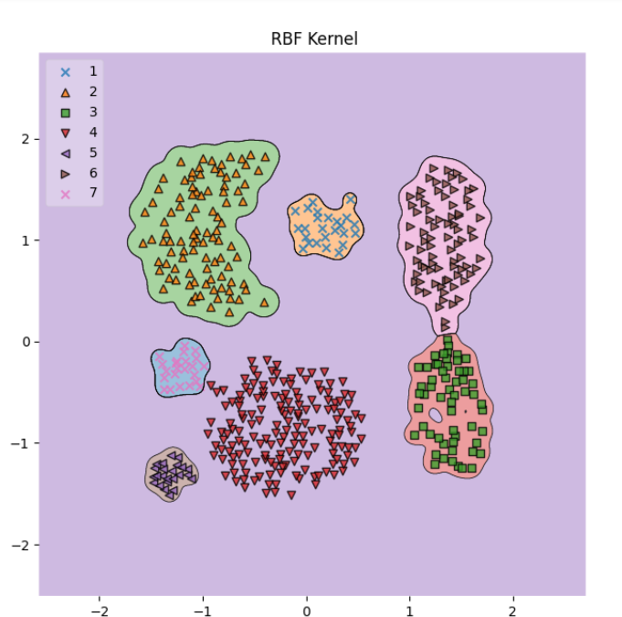
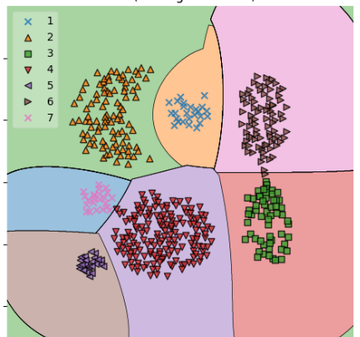
Gamma
The parameter gamma in machine learning, particularly in algorithms like support vector machines with the radial basis function (RBF) kernel, determines the influence of a single training example, with low values meaning 'far' and high values meaning 'close'. A low gamma will consider even far points in the calculation of the decision boundary, while a high gamma will only consider points close to the plausible boundary.

Slide 12
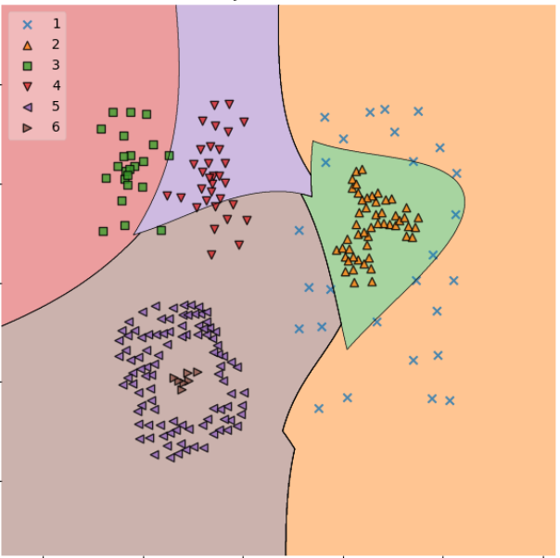
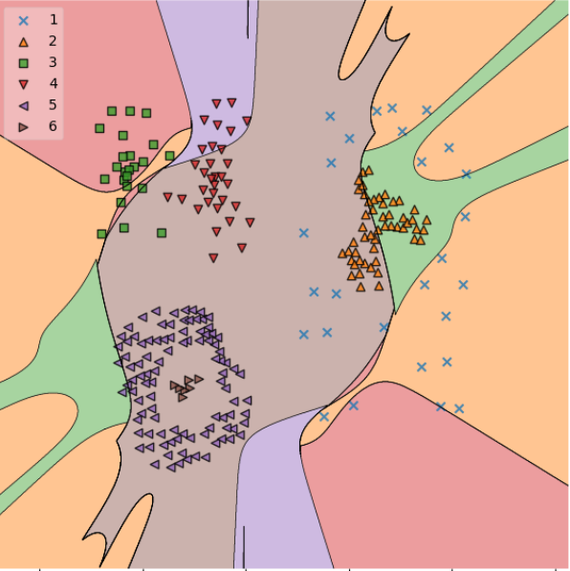
Degree
The parameter "degree" is specific to polynomial kernels in machine learning, such as the one used in support vector machines. It controls the degree of the polynomial used in the kernel function, thereby affecting the flexibility and complexity of the decision boundary. Higher degrees can lead to more intricate decision boundaries but may also increase the risk of overfitting, while lower degrees may oversimplify the boundaries and result in underfitting.

Slide 13
Implementation
Utilization of Python programming language.Implementation with popular libraries such as numpy, pandas,sklearn,matplotlib,mlxtend, and itertools for data manipulation, model building, and visualization.

Slide 14
Results
All resulted accuracy vary between 97.5% to 100% for validation and testing

Slide 15
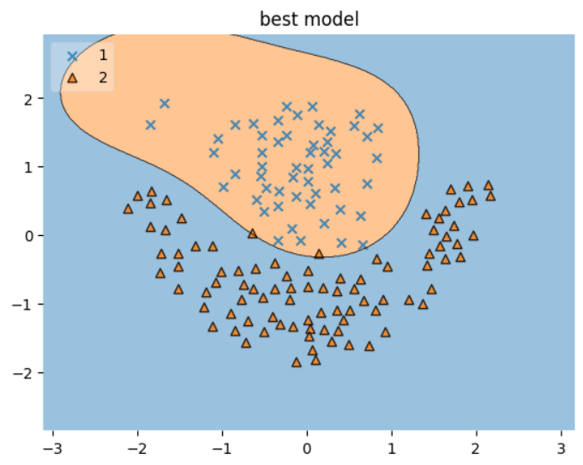
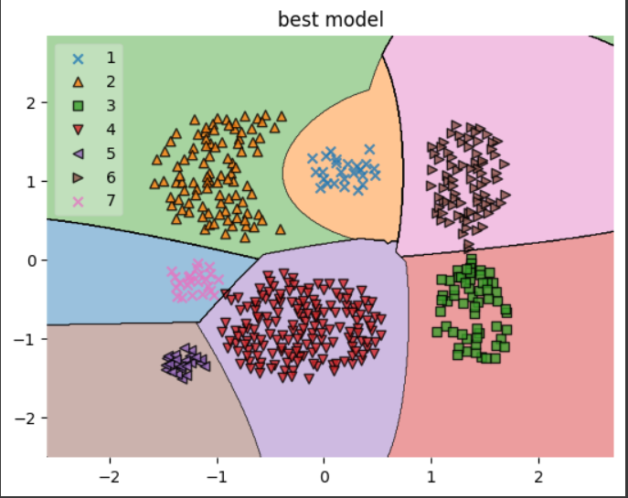
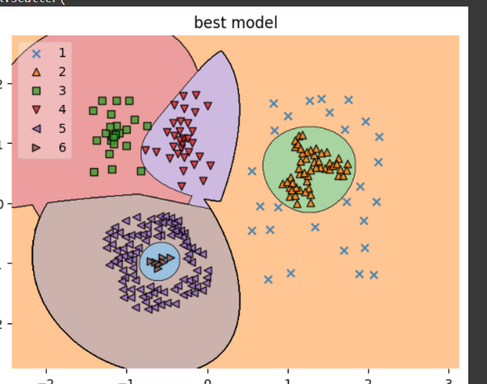
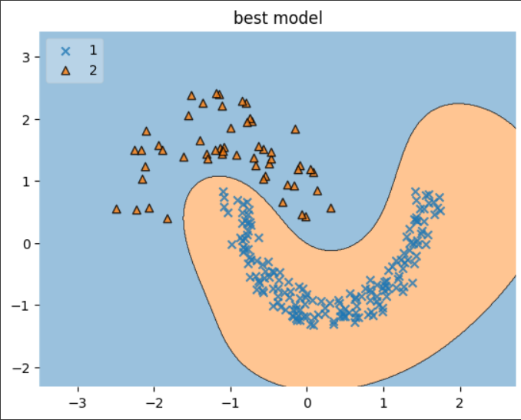
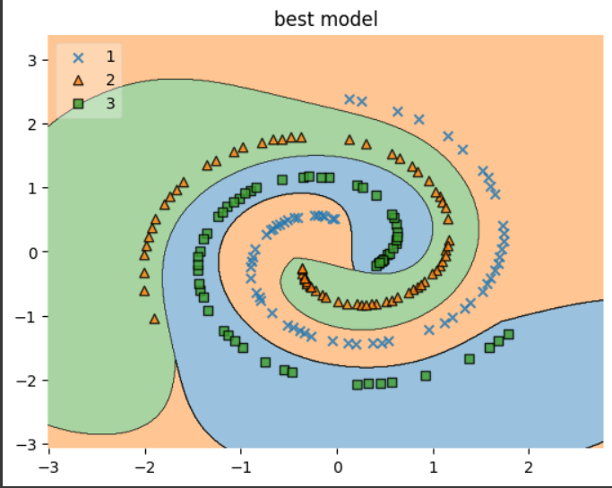
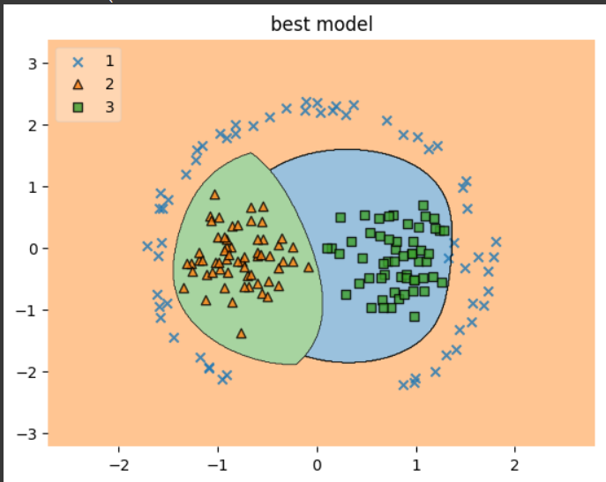
Best models

Slide 16
Conclusion
The study highlighted the influence of various kernels and regularization techniques on Support Vector Machine (SVM) classification. Comprehensive visualization provided insights into the models' behavior with different parameters, emphasizing the importance of proper parameter selection for effective classification. Valuable learning experiences were gained, pointing to the need for further exploration of additional kernels, regularization strategies, and optimization of feature engineering techniques to enhance model performance.

Slide 17
Thank you!

